Slide 1
N. Rizk
COSC 3337 : Data Science I
PROFESSOR HIGHLY Recommended to use interactive graphs
College of Natural and Applied Sciences
Department of Computer Science
University of Houston

Slide 2
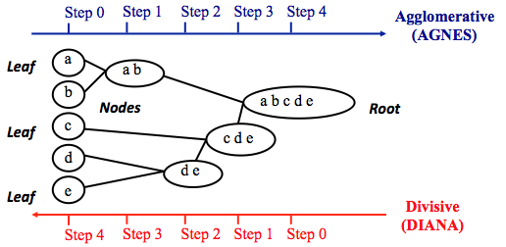
Hierarchical Agglomerative Clustering

Slide 3
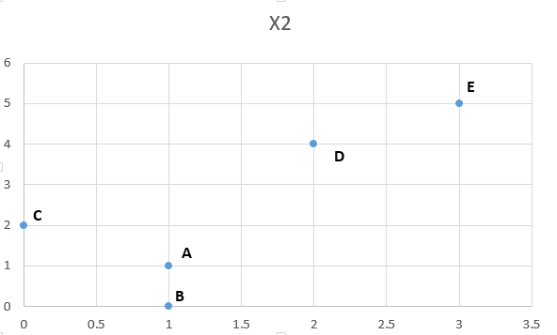
Example
 | X1 | X2
A | 1 | 1
B | 1 | 0
C | 0 | 2
D | 2 | 4
E | 3 | 5
 | A | B | C | D | E
A | 0.0 | 1.0 | 1.4 | 3.2 | 4.5
B | 1.0 | 0.0 | 2.2 | 4.1 | 5.4
C | 1.4 | 2.2 | 0.0 | 2.8 | 4.2
D | 3.2 | 4.1 | 2.8 | 0.0 | 1.4
E | 4.5 | 5.4 | 4.2 | 1.4 | 0.0

Slide 4
Step1 find the smallest distance
 | A | B | C | D | E
A | 0.0 | 1.0 | 1.4 | 3.2 | 4.5
B | 1.0 | 0.0 | 2.2 | 4.1 | 5.4
C | 1.4 | 2.2 | 0.0 | 2.8 | 4.2
D | 3.2 | 4.1 | 2.8 | 0.0 | 1.4
E | 4.5 | 5.4 | 4.2 | 1.4 | 0.0
 | A | B | C | D | E
A | 0.0 | 1.0 | 1.4 | 3.2 | 4.5
B | 1.0 | 0.0 | 2.2 | 4.1 | 5.4
C | 1.4 | 2.2 | 0.0 | 2.8 | 4.2
D | 3.2 | 4.1 | 2.8 | 0.0 | 1.4
E | 4.5 | 5.4 | 4.2 | 1.4 | 0.0
 | AB | C | D | E
AB | 1.0 | 1.8 | 3.6 | 4.9
C | 1.8 | 0.0 | 2.8 | 4.2
D | 3.6 | 2.8 | 0.0 | 1.4
E | 4.9 | 4.2 | 1.4 | 0.0
Linkage by average

Slide 5
Dendrogram
1
0
Minimum distance at 1
A
B
 | A | B | C | D | E
A | 0.0 | 1.0 | 1.4 | 3.2 | 4.5
B | 1.0 | 0.0 | 2.2 | 4.1 | 5.4
C | 1.4 | 2.2 | 0.0 | 2.8 | 4.2
D | 3.2 | 4.1 | 2.8 | 0.0 | 1.4
E | 4.5 | 5.4 | 4.2 | 1.4 | 0.0
 | AB | C | D | E
AB | 0 | 1.8 | 3.6 | 4.9
C | 1.8 | 0.0 | 2.8 | 4.2
D | 3.6 | 2.8 | 0.0 | 1.4
E | 4.9 | 4.2 | 1.4 | 0.0
Linkage by average

Slide 6

Next Step Smallest Value
 | AB | C | D | E
AB | 0 | 1.8 | 3.6 | 4.9
C | 1.8 | 0.0 | 2.8 | 4.2
D | 3.6 | 2.8 | 0.0 | 1.4
E | 4.9 | 4.2 | 1.4 | 0.0
 | AB | C | D | E
AB | 0 | 1.8 | 3.6 | 4.9
C | 1.8 | 0.0 | 2.8 | 4.2
D | 3.6 | 2.8 | 0.0 | 1.4
E | 4.9 | 4.2 | 1.4 | 0.0
Average 3.6 and 4.9 is the distance between DE and AB

Slide 7
Dendrogram
 | AB | C | D | E
AB | 0 | 1.8 | 3.6 | 4.9
C | 1.8 | 0.0 | 2.8 | 4.2
D | 3.6 | 2.8 | 0.0 | 1.4
E | 4.9 | 4.2 | 1.4 | 0.0
Minimum distance at 1.4
1.4
1
DE
1
AB
0
0
D
E
A
B
C
 | AB | C | DE
AB | 0 | 1.8 | 4.3
C | 1.8 | 0.0 | 3.5
DE | 4.3 | 3.5 | 0.0

Slide 8
FIND THE SMALLEST
 | AB | C | DE
AB | 0 | 1.8 | 4.3
C | 1.8 | 0.0 | 3.5
DE | 4.3 | 3.5 | 0.0
 | AB | C | DE
AB | 0 | 1.8 | 4.3
C | 1.8 | 0.0 | 3.5
DE | 4.3 | 3.5 | 0.0
 | ABC | DE
ABC | 0 | 4
DE | 4 | 0.0

Slide 9
Dendrogram
1.8
ABC
1.4
DE
1
1
AB
Minimum distance at 1.8
0
0
D
E
A
B
C
 | AB | C | DE
AB | 0 | 1.8 | 4.3
C | 1.8 | 0.0 | 3.5
DE | 4.3 | 3.5 | 0.0
 | ABC | DE
ABC | 0 | 4
DE | 4 | 0.0

Slide 10
Dendrogram
4
ABCDE
1.8
ABC
1.4
Minimum distance at 4
DE
1
1
AB
0
0
D
E
A
B
C
 | ABC | DE
ABC | 0 | 4
DE | 4 | 0.0

Slide 11
Threshold
4
ABCDE
2 clusters at threshold 3
1.8
ABC
2 clusters and one outlier at threshold 1.5
1.4
DE
1
1
AB
0
0
D
E
A
B
C
Optimal threshold can be the mid point of the longest branch 4/2=2

Slide 12
Linkage Methods of Clustering
Single Linkage
Minimum Distance
Cluster 1
Cluster 2
Complete Linkage
Maximum Distance
Cluster 1
Cluster 2
Average Linkage
Average Distance
Cluster 1
Cluster 2

Slide 13
Repeat this example with Single linkage (select the minimum distance instead of average) ➔ Euclidean , Single Linkage
 | A | B | C | D | E
A | 0.0 | 1.0 | 1.4 | 3.2 | 4.5
B | 1.0 | 0.0 | 2.2 | 4.1 | 5.4
C | 1.4 | 2.2 | 0.0 | 2.8 | 4.2
D | 3.2 | 4.1 | 2.8 | 0.0 | 1.4
E | 4.5 | 5.4 | 4.2 | 1.4 | 0.0
 | AB | C | D | E
AB | 1.0 | 1.4 | 3.6 | 4.9
C | 1.8 | 0.0 | 2.8 | 4.2
D | 3.6 | 2.8 | 0.0 | 1.4
E | 4.9 | 4.2 | 1.4 | 0.0

Slide 14
Repeat this example with complete linkage (select the maximum distance instead of average) ➔ Euclidean , complete Linkage
 | A | B | C | D | E
A | 0.0 | 1.0 | 1.4 | 3.2 | 4.5
B | 1.0 | 0.0 | 2.2 | 4.1 | 5.4
C | 1.4 | 2.2 | 0.0 | 2.8 | 4.2
D | 3.2 | 4.1 | 2.8 | 0.0 | 1.4
E | 4.5 | 5.4 | 4.2 | 1.4 | 0.0
 | AB | C | D | E
AB | 1.0 | 2.2 | 3.6 | 4.9
C | 1.8 | 0.0 | 2.8 | 4.2
D | 3.6 | 2.8 | 0.0 | 1.4
E | 4.9 | 4.2 | 1.4 | 0.0

Slide 15
Hierarchical Divisive Clustering example

Slide 16
Hierarchical K-Means =top down
Run K-means on the original set of n objects
Apply k means , split recursively (same K) until a singleton cluster
Complexity O(KndLog _{k} n)➔fast
Disadvantage nearest points may end up in different clusters

Slide 17
Hierarchical Agglomerative Clustering-Variance and Centroid Method
Variance methods generate clusters to minimize the within-cluster variance.
Ward's procedure is commonly used. For each cluster, the sum of squares is calculated. The two clusters with the smallest increase in the overall sum of squares within cluster distances are combined.
In the centroid methods, the distance between two clusters is the distance between their centroids (means for all the variables),
Of the hierarchical methods, average linkage and Ward's methods have been shown to perform better than the other procedures.

Slide 18
Other Agglomerative Clustering Methods
Ward’s Procedure
Repeat the example using
Ward’s procedure!
Centroid Method

Slide 19
Ward’s Method (Minimum variance method)
Like other clustering methods, Ward’s method starts with n clusters, each containing a single object. These n clusters are combined to make one cluster containing all objects. At each step, the process makes a new cluster that minimizes variance , measured by an index called E (also called the sum of squares index).

Slide 20
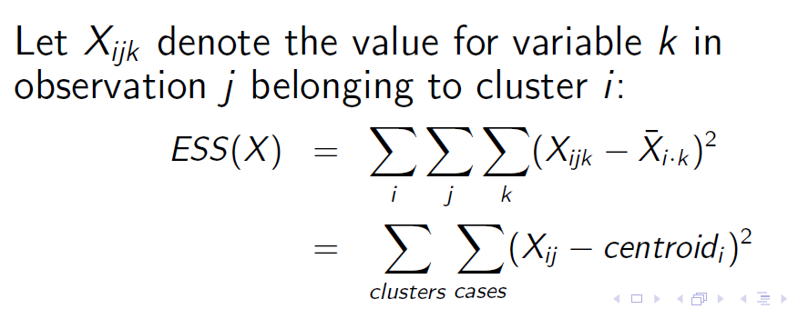
ESS? Sum of squares
At each step, the following calculations are made to find E:
Find the mean of each cluster.
Calculate the distance between each object in a particular cluster, and that cluster’s mean.
Square the differences from Step 2.
Sum (add up) the squared values from Step 3.
Add up all the sums of squares from Step 4.

Slide 21
At the beginning each case is a cluster.
In the first step of the algorithm, n − 1 clusters are formed, one of size two and the remaining of size 1. The error sum of squares is computed. The pair of sample units that yield the smallest ESS will form the first cluster.
Then, in the second step of the algorithm n − 2 clusters are formed from that n − 1 clusters defined in step 2. These may include two clusters of size 2, or a single cluster of size 3 including the two items clustered in step 1.
Again, the value of ESS is minimized.
Thus, at each step of the algorithm clusters or observations are combined in such a way as to minimize the results of error from the squares.
The algorithm stops when all sample units are combined into a single large cluster of size n.

Slide 22
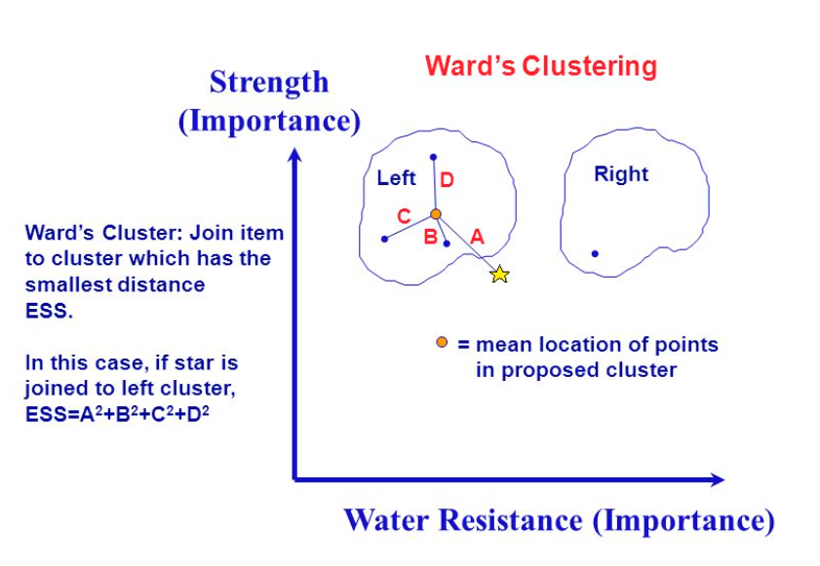

Slide 23
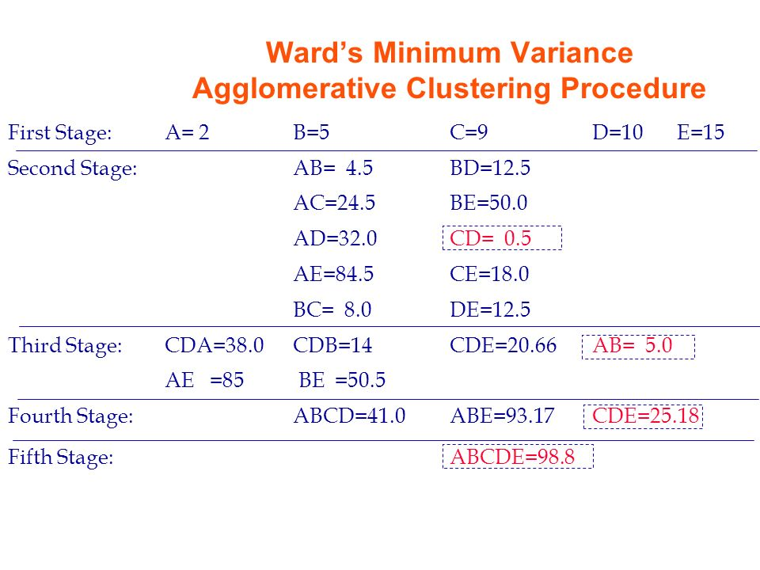
one of size two and the remaining of size 1
CD, A,B,E
CD =(10-9)^2 /2 = 1/2=0.5
two clusters of size 2 (CD,AB, a single cluster of size 1
AB, CDE,
ABCDE

Slide 24
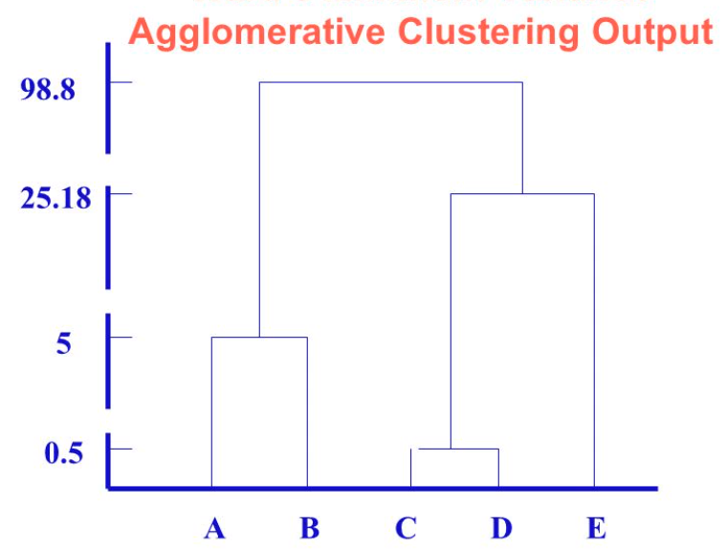

Slide 25
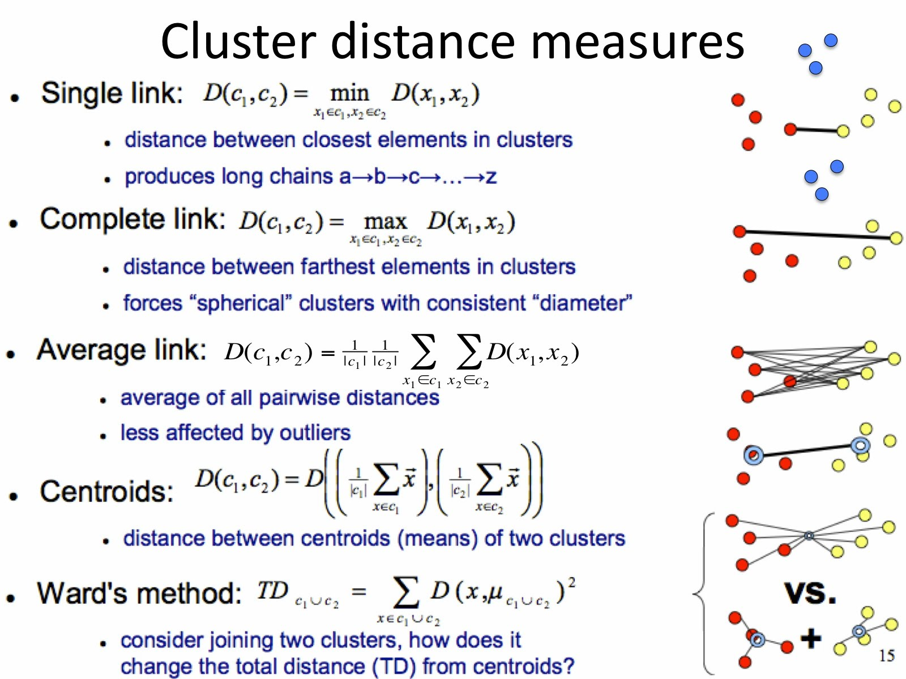

Slide 26
import matplotlib.pyplot as plt
from pandas import DataFrame
from sklearn.cluster import AgglomerativeClustering
Data = {
'x': [35,34,32,37,33,33,31,27,35,34,62,54,57,47,50,57,59,52,61,47,50,48,39,40,45,47,39,44,50,48],
'y': [79,54,52,77,59,74,73,57,69,75,51,32,40,47,53,36,35,58,59,50,23,22,13,14,22,7,29,25,9,8]
}
df = DataFrame(Data,columns=['x','y'])
cluster = AgglomerativeClustering(n_clusters=3, affinity='euclidean', linkage='ward')
cluster.fit_predict(df)
plt.scatter(df['x'], df['y'], c=cluster.labels_, cmap='rainbow')
plt.title('Ward');
plt.show()
cluster = AgglomerativeClustering(n_clusters=3, affinity='euclidean', linkage='single')
cluster.fit_predict(df)
plt.scatter(df['x'], df['y'], c=cluster.labels_, cmap='rainbow')
plt.title('Single')
plt.scatter(df['x'], df['y'], c=cluster.labels_, cmap='rainbow')
plt.show()

Slide 27
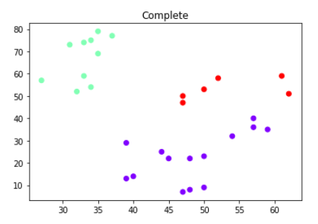
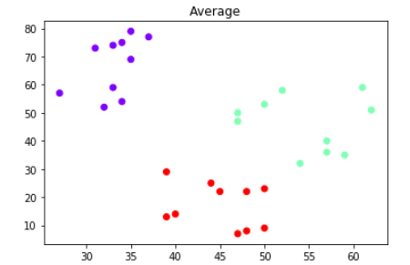
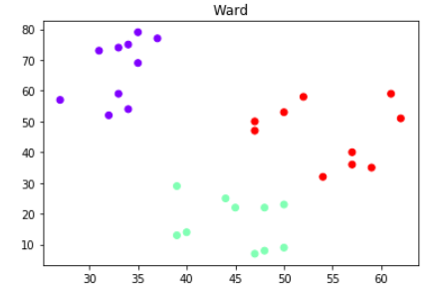
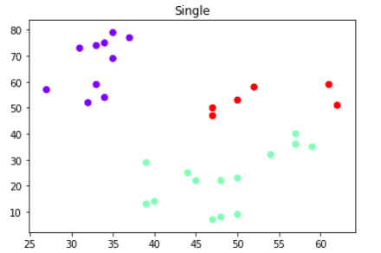
cluster = AgglomerativeClustering(n_clusters=3, affinity='euclidean', linkage='complete')
cluster.fit_predict(df)
plt.scatter(df['x'], df['y'], c=cluster.labels_, cmap='rainbow')
plt.title('Complete')
plt.show()
cluster = AgglomerativeClustering(n_clusters=3, affinity='euclidean', linkage='average')
cluster.fit_predict(df)
plt.scatter(df['x'], df['y'], c=cluster.labels_, cmap='rainbow')
plt.title('Average')
plt.show()

Slide 28
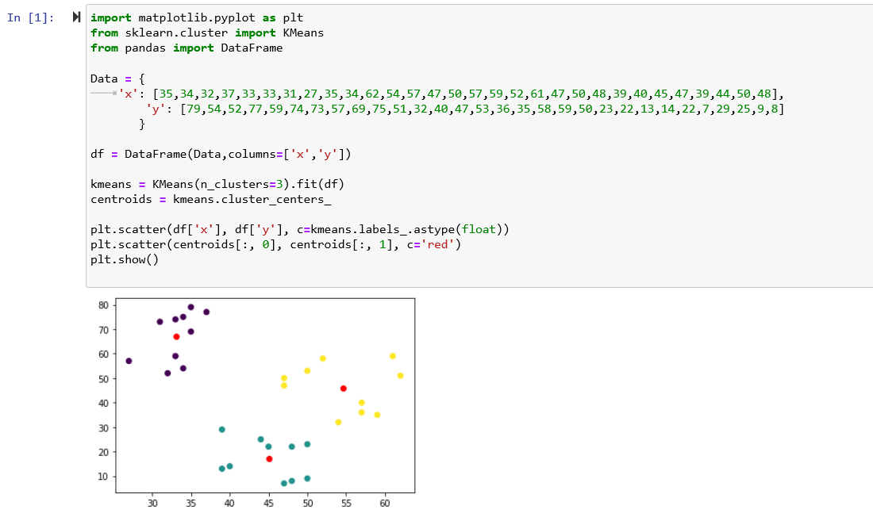
ADVANTAGES: EVERYTHING IS COUNTED Agglomerative.
Red Dots are MEAN

Slide 29
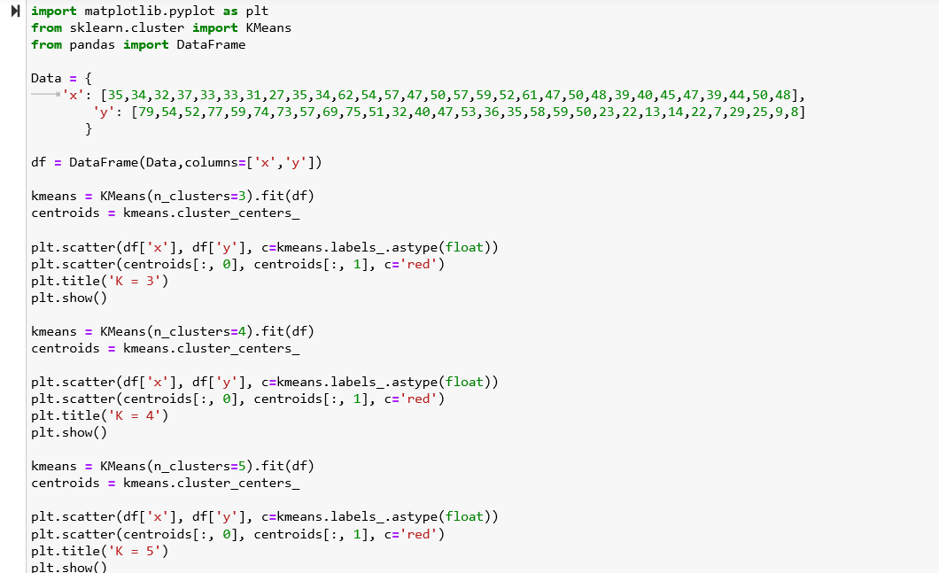

Slide 30
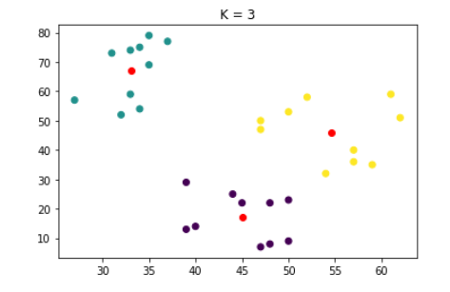
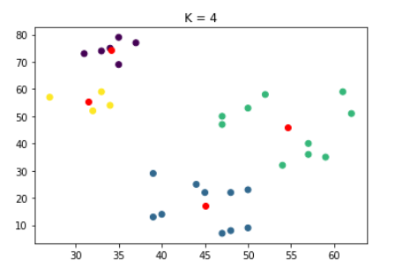
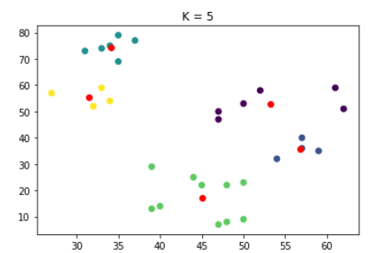

Slide 31
